Slide 1


Rhoades Training Group
Capabilities Brief
Firearms Training
Medical Training
Less-Lethal Training
Teaching Gunfighting Since 2022

Slide 2
Directory
Directory ……………………………………………….……………………2
About Us ……………………………………………………………………3
Our Partners ……………………………………………………………..4
RTG Map ……………………………………………………………………5
Accommodations …………………………………………………….6
Firearms Training …………………………………………..………..7
Medical Training ……………………………………..…….……….10
Less-Lethal Training ………………………………………..…….11

Slide 3
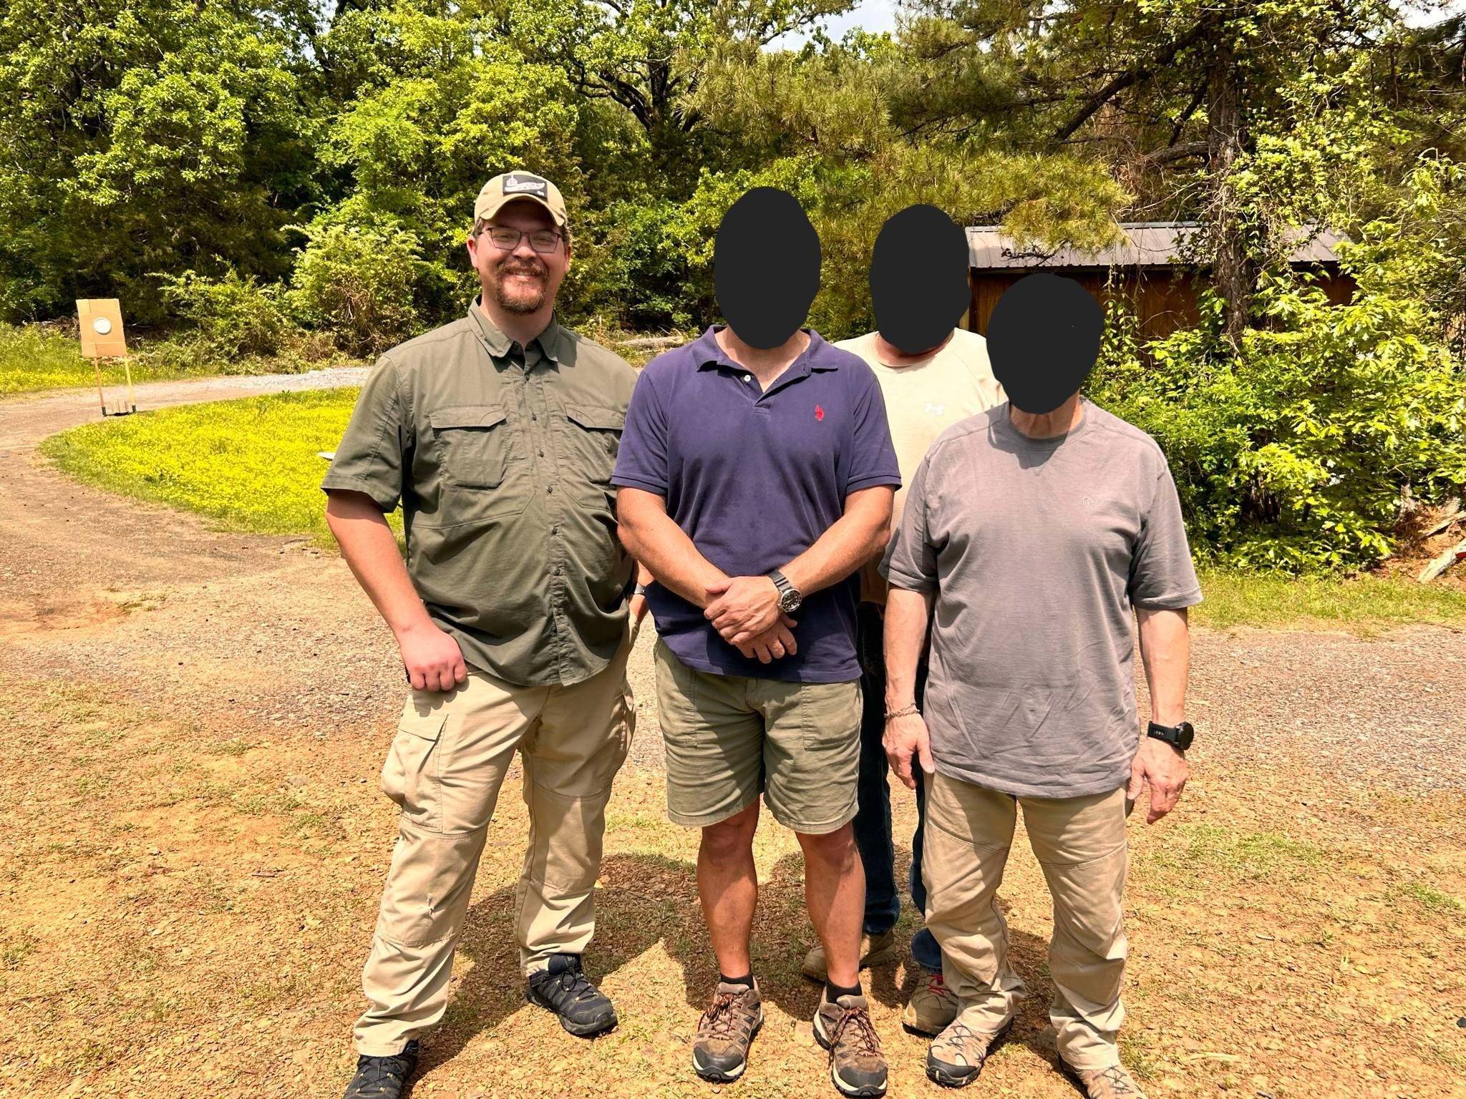
About Us
3-acre training facility
100% of our staff instructors have security, military, and/or law enforcement experience
Just minutes away from Fort Chaffee Joint Maneuver Center, Ebbing Air National Guard Base, and the Mena National Guard Armory
Force on Force Role Players
Two Handgun/Shotgun Flat Ranges & 250 yard Rifle Range
24’x30’ Classroom (Can seat <17 students)
Our past students are comprised of 81% male, 19% female, and their average age is 39. We have taught students who have never shot a firearm before to retired federal agents from the USBP and FBI. Our alumni have reported 0 gunfights to us since training with RTG.
NAICS: 611519, 611699

Slide 4


Our Partners

Slide 5
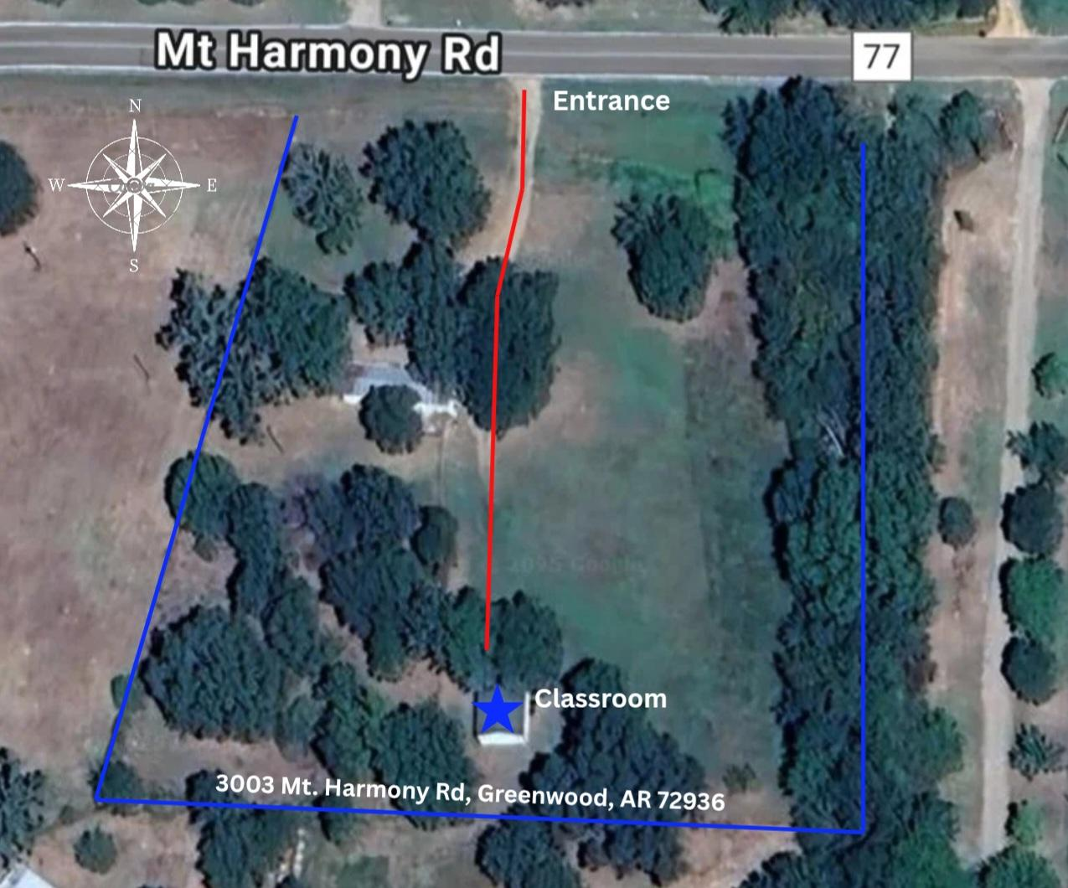
RTG Map
RTG maintains a 3-acre training facility that includes a 24’x30’ classroom which can seat <17 students, two vehicles for Force on Force training, plenty of space for student parking, and a handgun & shotgun flat range.
1.7 miles east is another property we use for it's 250 yard rifle range and handgun & shotgun flat range.

Slide 6
Accommodations
Room & Board:
La Quinta Inn & Suites by Wyndham (479)595-0041
Quality Inn & Suites (479)632-4141
Days Inn by Wyndham (479)439-5983
Transportation:
Enterprise Rent-A-Car (479)648-1117
Hertz Car Rental (479)649-0961
Axis Car Rental (479)452-5152
Airport:
Northwest Arkansas National Airport (XNA)
Fort Smith Regional Airport (FSM)
Dining:
China City (Chinese Buffet) (479)648-8698
Blue Ember Smokehouse (BBQ) (479)551-2999
La Huerta Authentic Mexican Food (479)471-0113
We have many hotels and restaurants in our area but have chosen to list a few of our favorite and closest. Other options would include utilizing Airbnb's website to find accommodations.
Mercy Hospital Fort Smith
7301 Rogers Ave, Fort Smith, AR 72903
(479)314-6245
24/7 Access
Level III Trauma Center
30 min (20 mi) drive from RTG

Slide 7
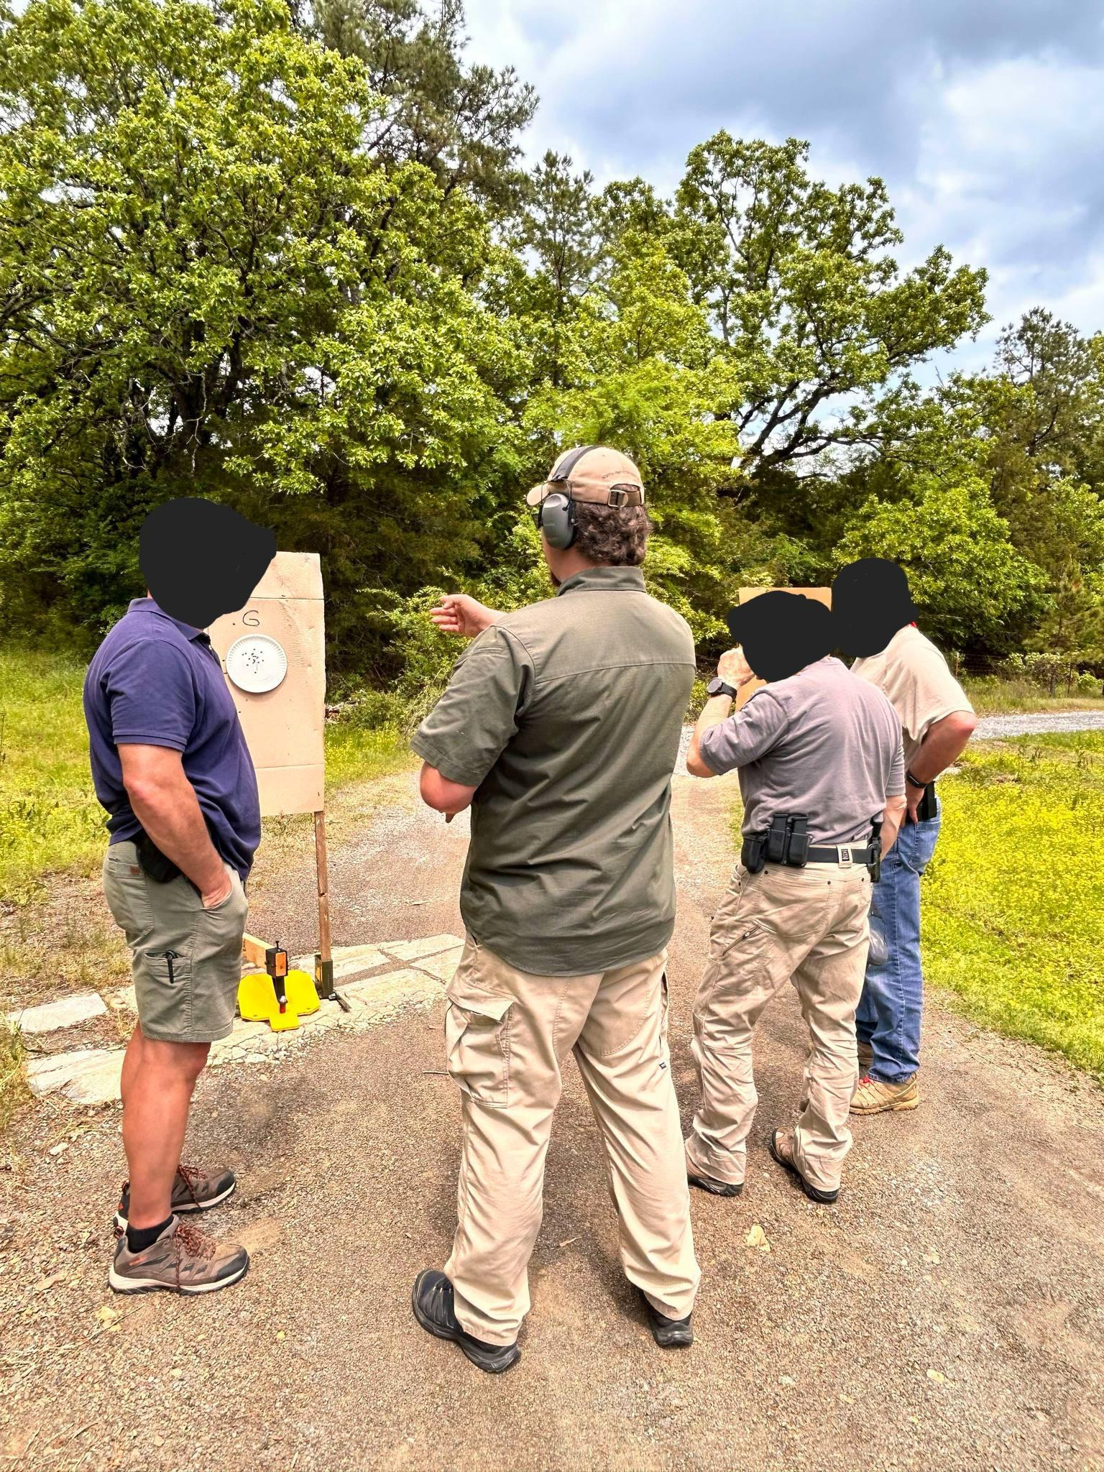
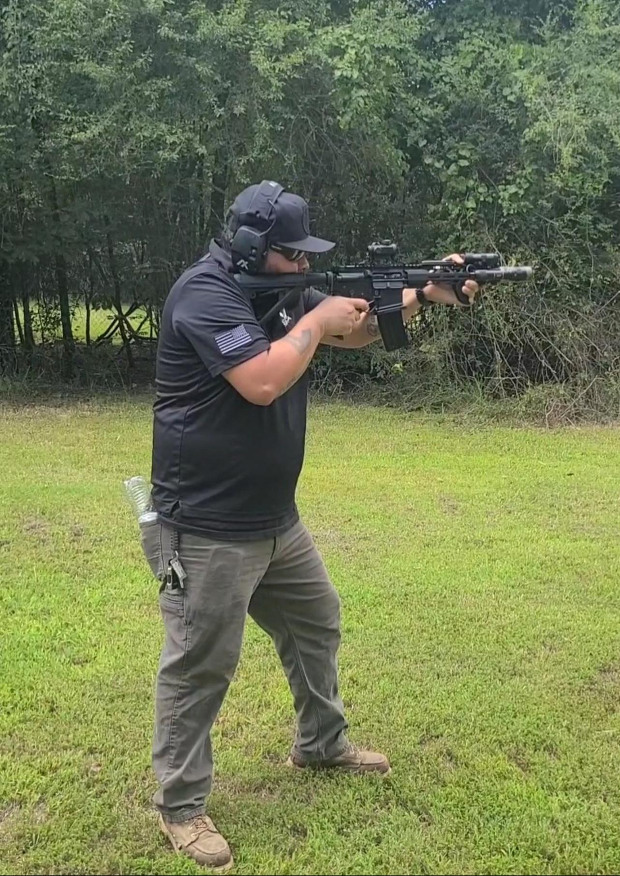
Firearms Training
Tactical Handgun, Rifle, & Shotgun
The comprehensive Tactical Handgun, Rifle, and Shotgun courses are designed for individuals looking to excel firearm capability and skills in high-stress, real-world scenarios. These courses focus on building marksmanship, speed, and confidence by preparing students to handle a variety of tactical situations, including shooting from vehicles and low-light/no-light environments. (16 to 48 hours)
Designated Defensive Marksman
Designed to improve marksmanship skills at close to mid-range distances. This comprehensive training course focuses on equipping students to shoot stationary and moving targets at known and unknown distances, how to utilize data on previous engagements (DOPE), traditional standing, sitting, and prone positions, shooting from a tripod, advanced instruction on internal, external, and terminal ballistics, and field craft techniques. (32 hours)

Slide 8
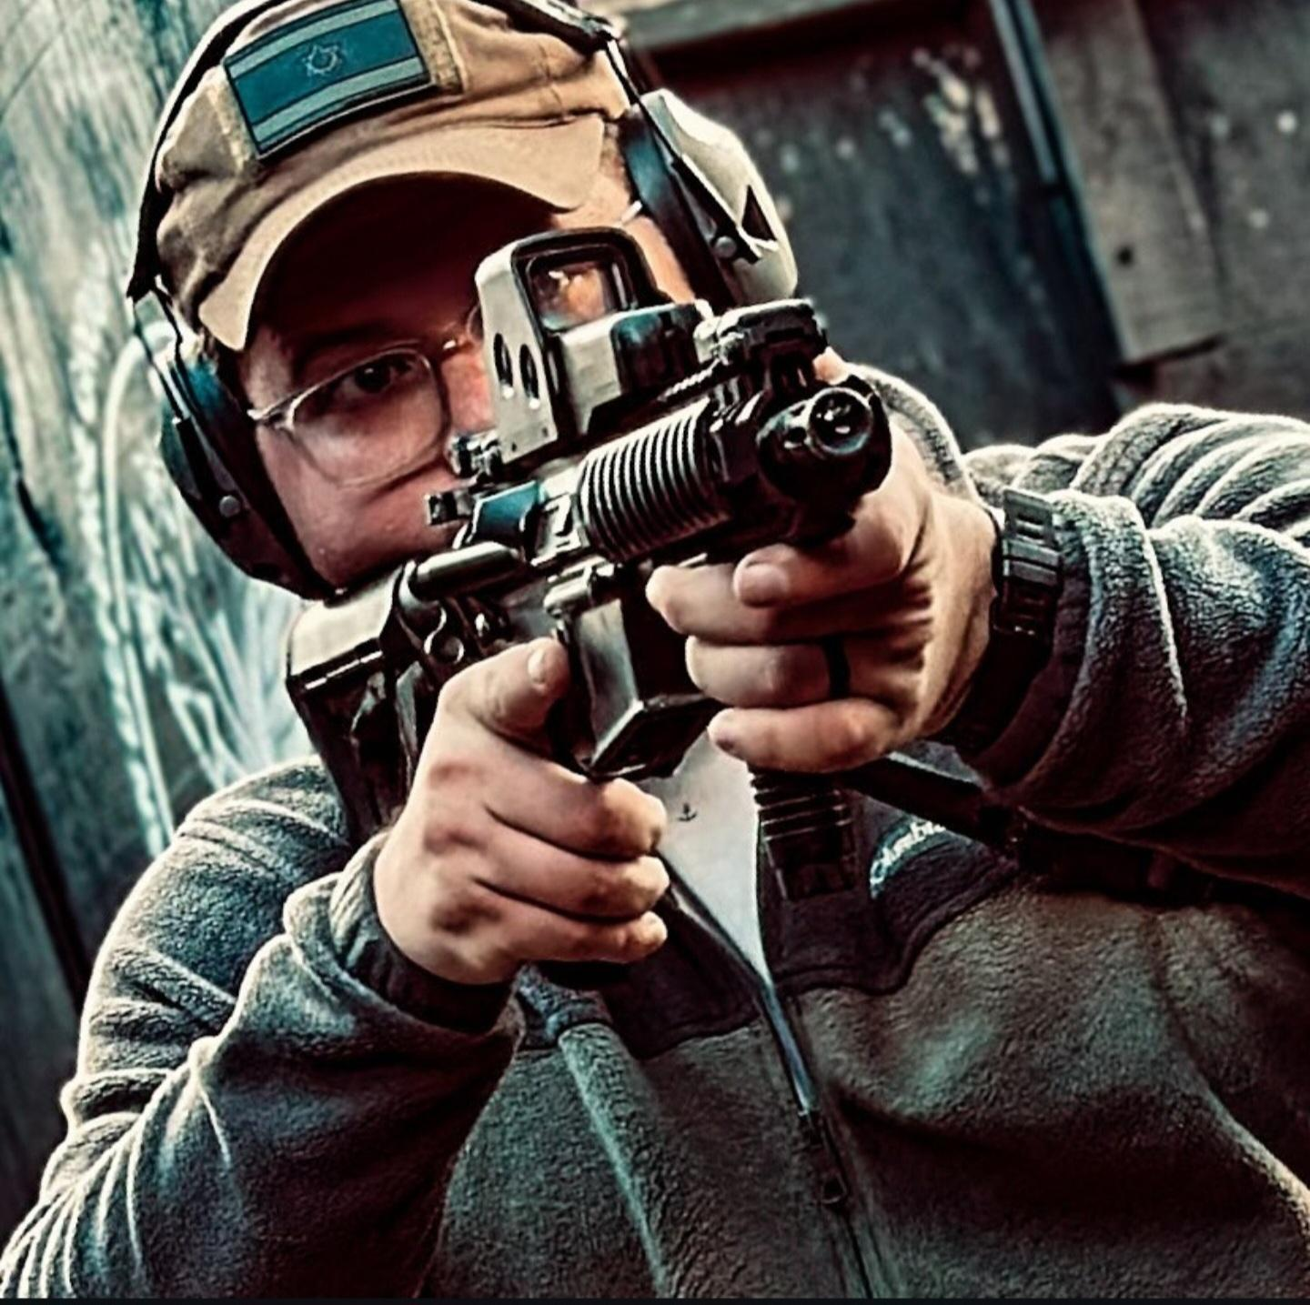
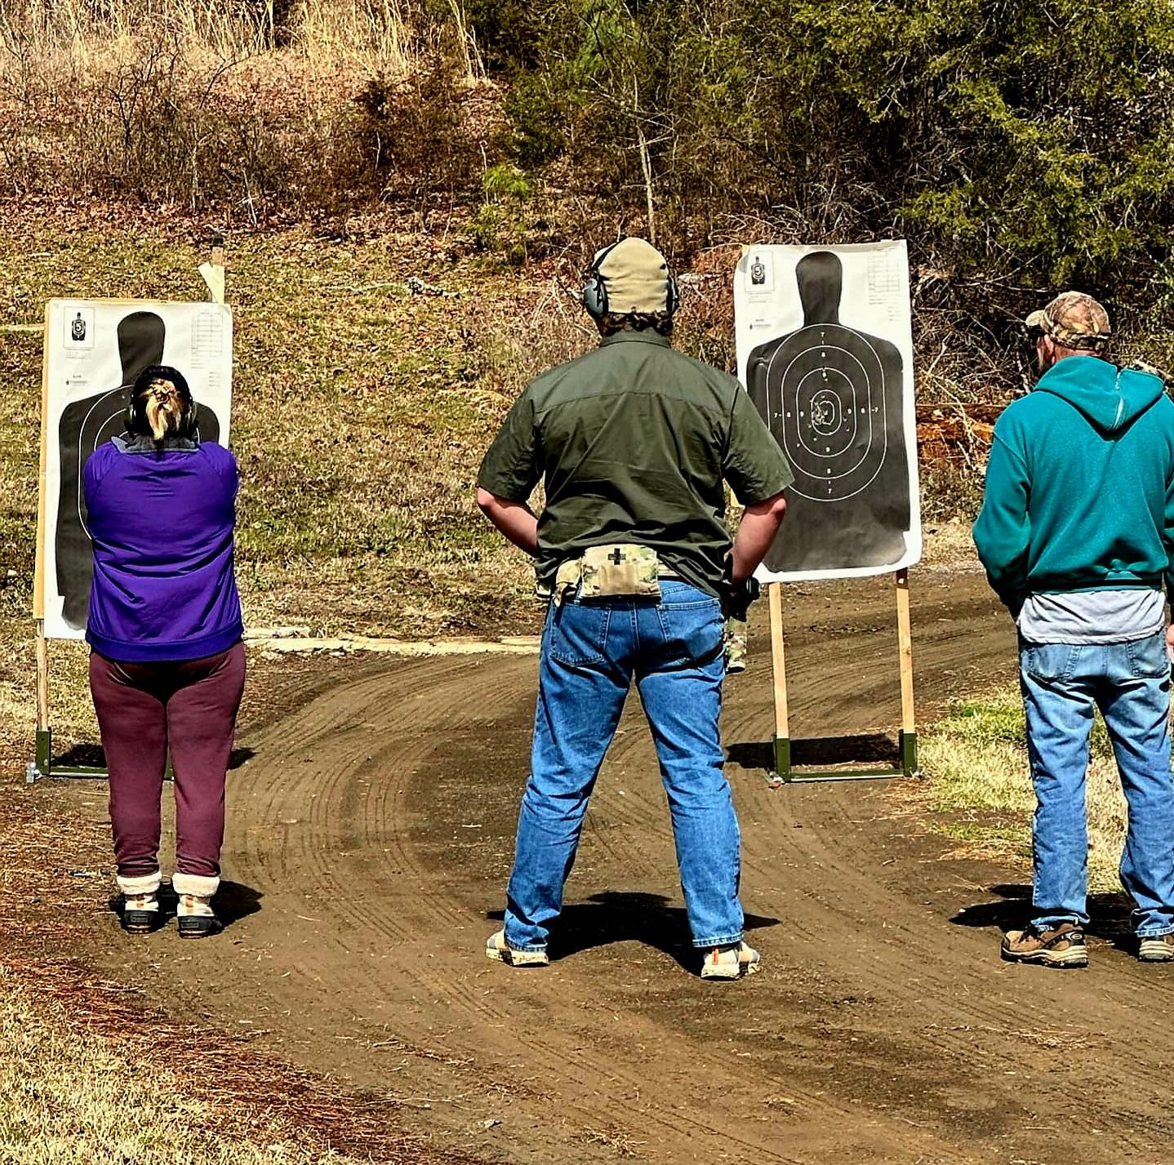
Firearms Training - Continued
Executive Protection
Designed for professionals providing discreet protection for HNWI and UHNWI. This course covers discreet protection tactics, surveillance & counter-surveillance, route planning, advance teams, and threat mitigation. Students engage in realistic force-on-force training scenarios, practicing real-world responses to threats. (40 hours)
Arkansas’ Concealed Handgun Carry License (CHCL) & Enhanced Concealed Handgun Carry License (E-CHCL)
These state-certified courses cover firearm safety, carry permit laws, and use of force. The Enhanced option adds additional marksmanship and legal training for carrying in restricted areas. (8 to 16 hours)

Slide 9


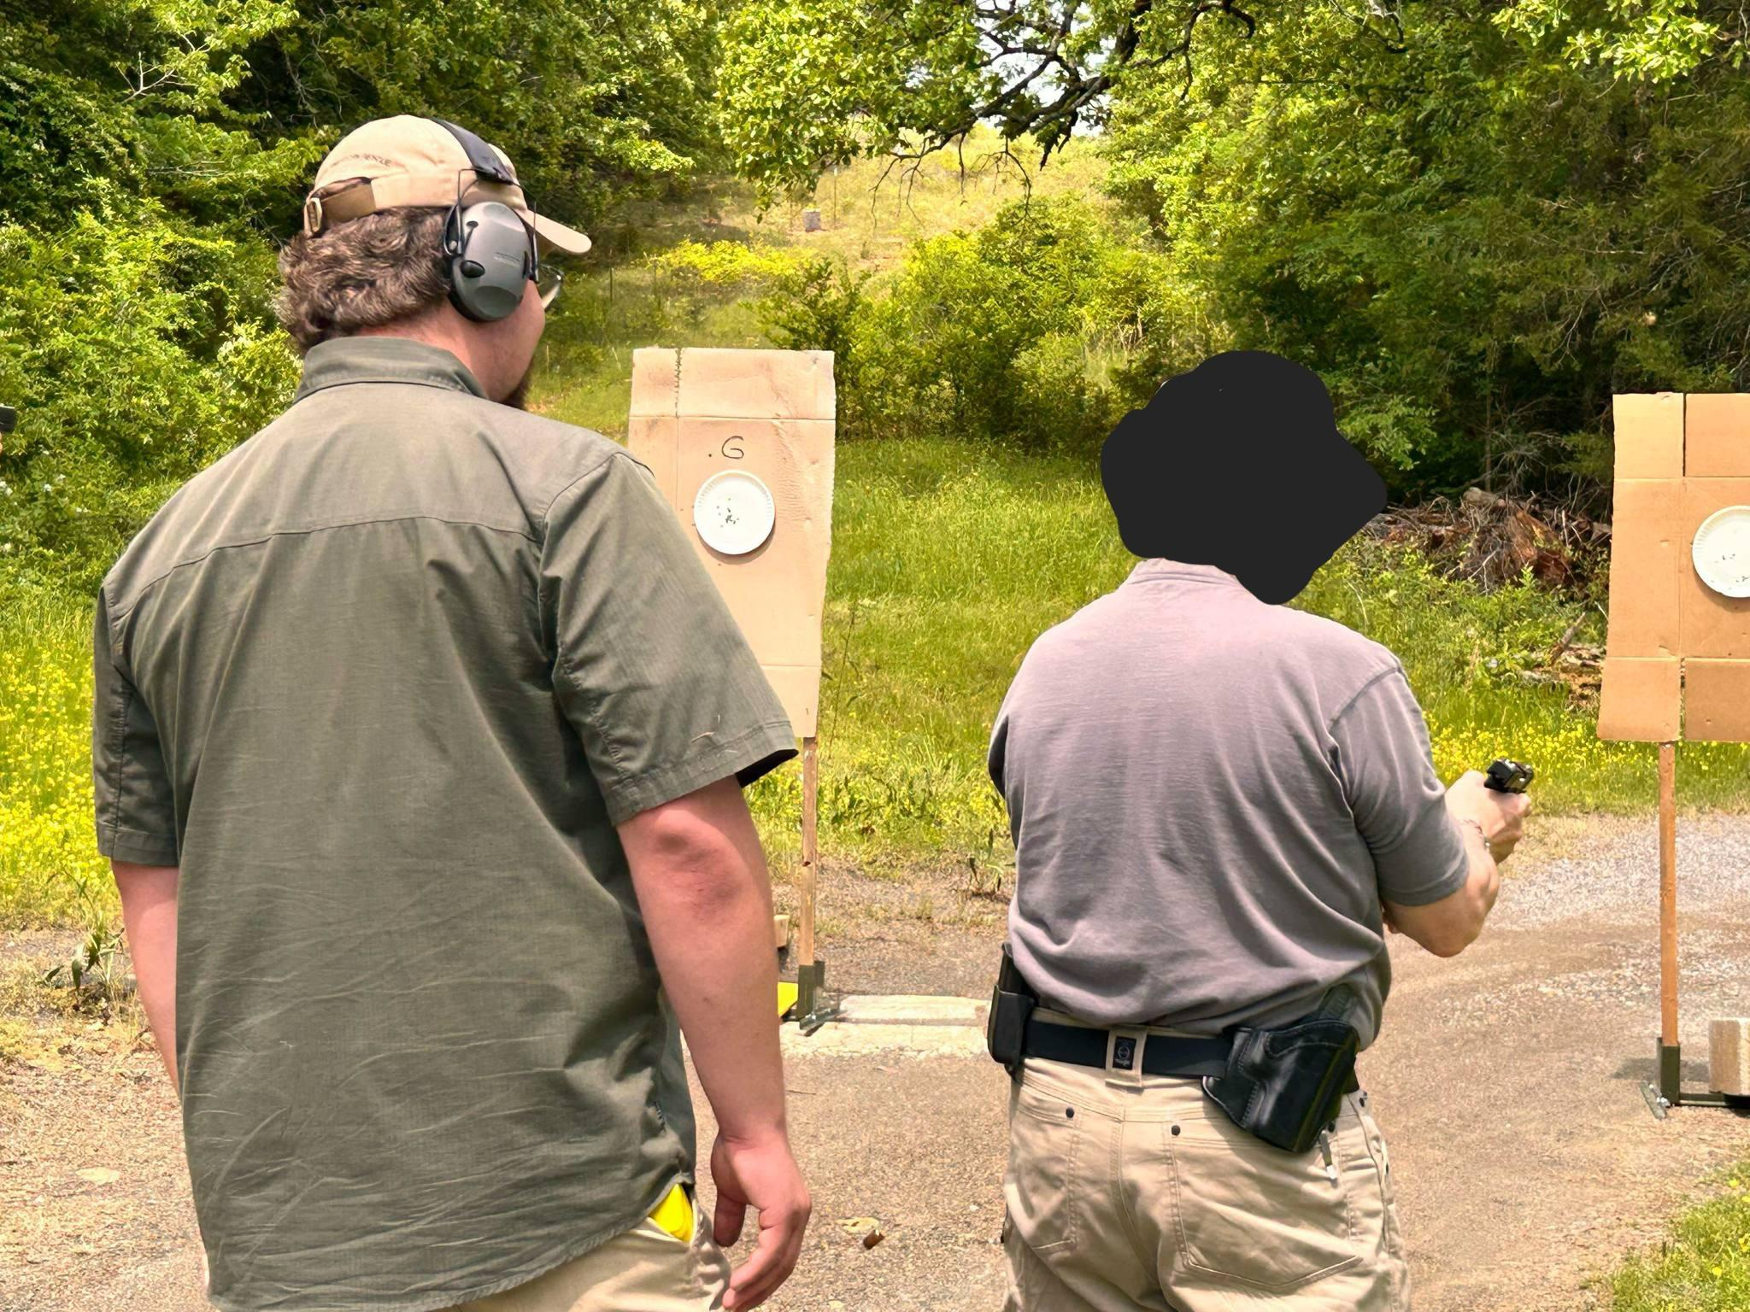
Firearms Training - Continued
NRA Certified Training
Our NRA-certified courses provide expert instruction in Pistol, Rifle, and Shotgun fundamentals, along with the Range Safety Officer course for those seeking to supervise safe range operations. Whether you're new to firearms or pursuing certification, these programs build confidence, skill, and safety awareness for all experience levels. (8 to 32 hours)
USCCA Concealed Carry & Home Defense Fundamentals Course (CCHDF)
This course teaches the basics of concealed carry, home defense, and personal protection. Students learn conflict avoidance, defensive shooting, and legal use of force. Ideal for all experience levels, it prepares participants for real-world threats. (8 hours)

Slide 10
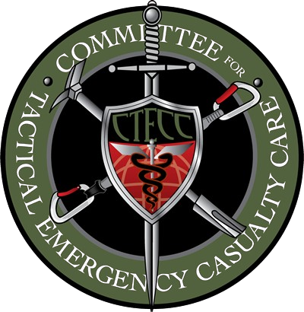

Medical Training
Stop The Bleed Course
This hands-on course teaches life-saving bleeding control techniques, including the use of direct pressure, wound packing, and tourniquets. Designed for anyone, it empowers participants to act quickly and effectively in emergencies. (2 hours)
Tactical Emergency Casualty Care (TECC)
This course follows the Co-TECC guidelines and prepares individuals to provide lifesaving trauma care in high-threat situations. It covers bleeding control, airway management, casualty evacuation, and includes realistic force-on-force training scenarios. (16 hours)
RTG utilizes Co-TCCC approved non-pneumatic, limb tourniquets and hemostatic dressing training aids for all medical courses.
Mannequins and other simulated patient training aids are used as needed.

Slide 11
Less-Lethal Training
ASP Basic Certification (ABC)
This certification program is designed to familiarize participants with the operational use of expandable batons, handcuffs, and/or flashlights. Certification signifies that the participant has met competency-based standards in both knowledge and practical performance. (4 to 16 hours)
Sabre Red User Course
This comprehensive course is designed to certify individuals in the safe, effective, and legally defensible use of Sabre Red Oleoresin Capsicum (OC) aerosol defense products. The curriculum includes the physiological effects of OC, proper deployment techniques, decontamination procedures, and use-of-force considerations. (4 hours)

Slide 12

rhoadestraininggroup.wordpress.com
Tel: (479)383-7411
NAICS: 611519, 611699

